Slide 1

The Science of Statistics
Just a Peek

Slide 2


Slide 3
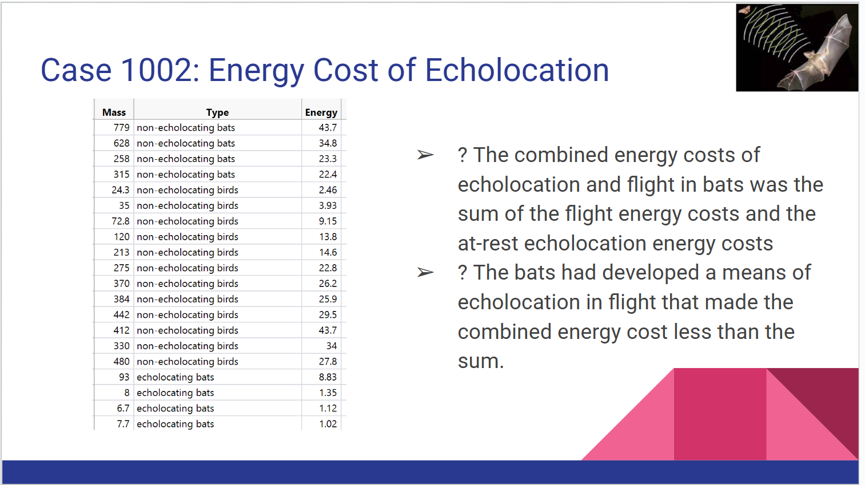
Why do we want to learn STATISTICS?

Slide 4
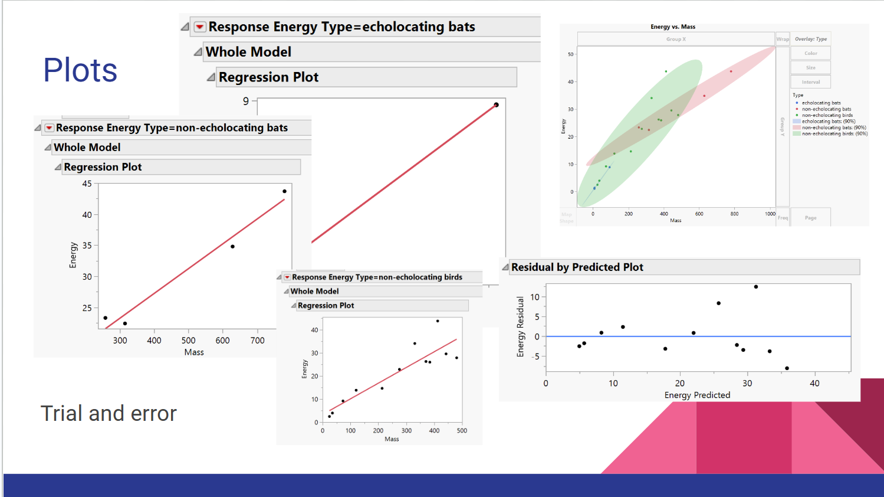
Graphical Summary

Slide 5
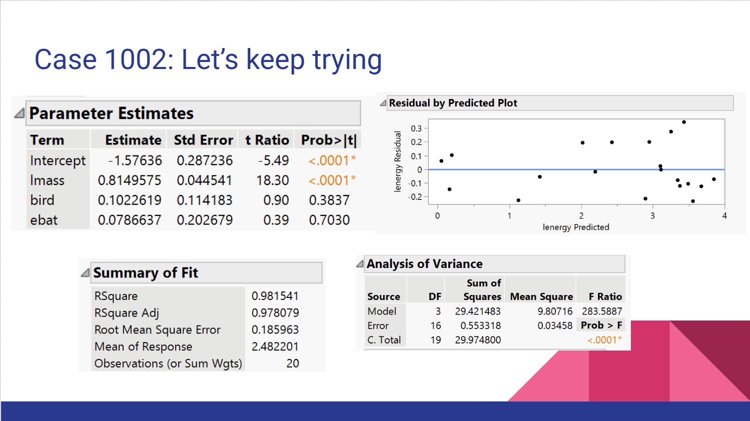
Statistics and Inferences

Slide 6
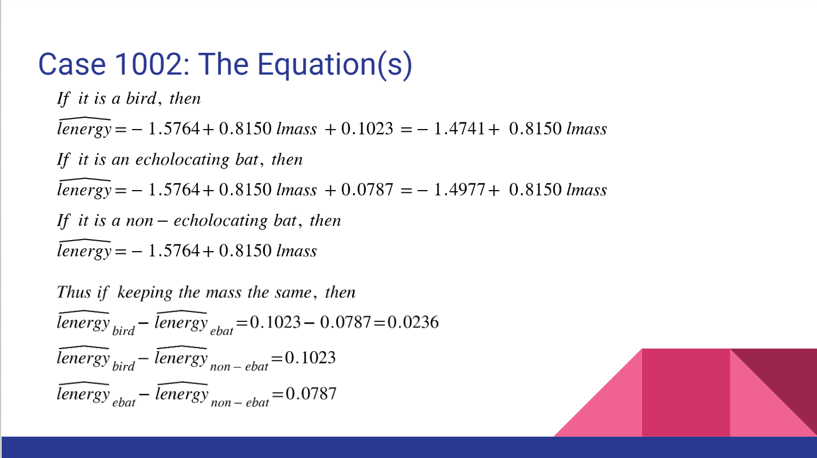
Statistical Models

Slide 7
Descriptive Statistics
Statistical Relationship
Statistical Conclusions
Probabilities
…..

Slide 8
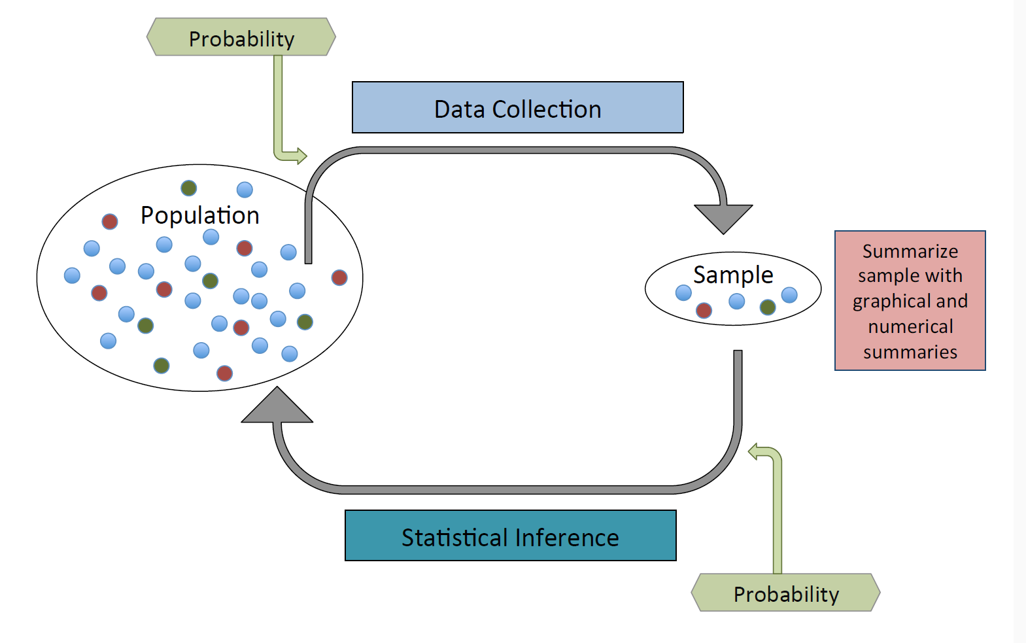
The Plan

Slide 9
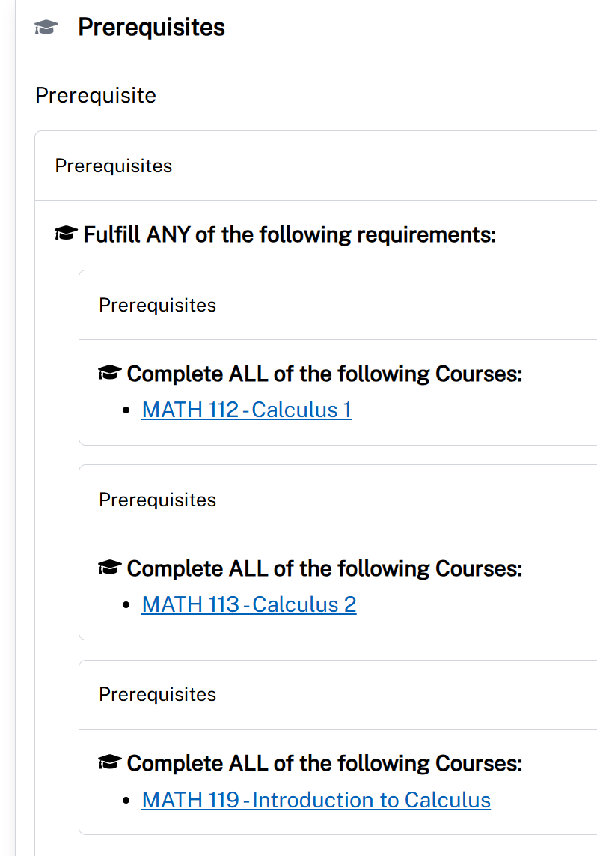
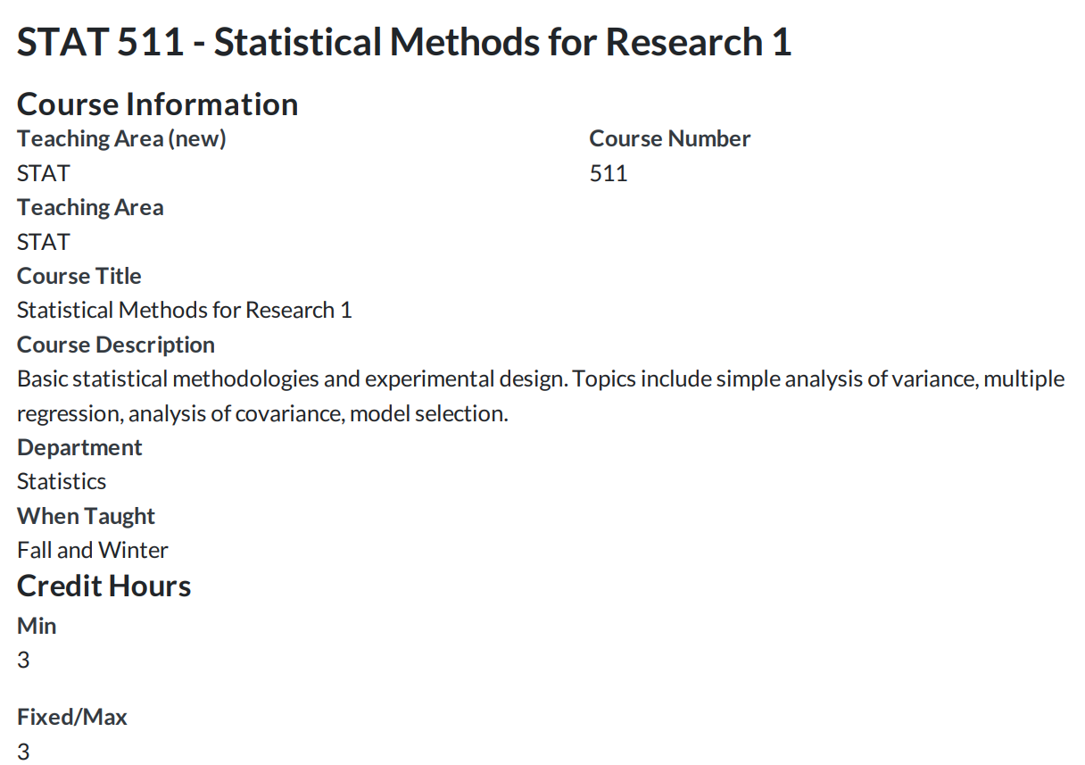
Before and After

Slide 10
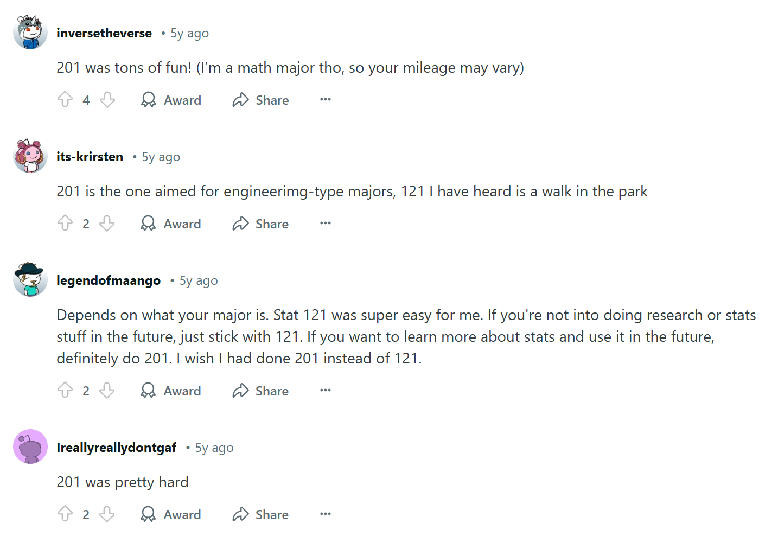
What’s the difference between 121 and 201?
Data from many years ago
May not be proper for now

Slide 11
The Goals
Fundamental Concepts
Terminologies and Their Definitions
Study Designs
Descriptive statistics
Graphical Summaries
Probability Theory
Statistical Inference: Basic Tools
Experimental Designs
Analysis of Variance
Simple Linear Regression
Additional Materials from the Textbook

Slide 12
The Tools
R Programming Language
Python
Learning Suite
ChatGPT
Wikipedia
Search Engine
Textbook

Slide 13



The Trick
Do the homework
Attend class
Stay current
Stay connected
Don’t procrastinate
Read books

Slide 14

From Come Follow Me 2025 April

Slide 15
Typos?
Please email me any typos and errors you found in this lesson.
Thank you!

